Slide 1

Olist eCommerce-Analytics
Sneha Rani Sarkar
PGA-25

Slide 2



Olist a Brazilian e-commerce
Introduction
Data Schema
Cohort Analysis
Year/month wise new customer registration
Galvanization by Product Categories
Statistical check of numerical variables
Principal Component Analysis
K-Means Clustering
Silhouette Score
Important Variables For Defining Clusters

Slide 3




Introduction
Olist is a Brazilian department store that operates in the e-commerce segment, but is not an e-commerce itself. It has been operating as a SaaS technology company since 2015. It offers store owners of any size a marketplace solution in the e-commerce segment to increase their sales, whether they have an online presence or not. So, the main goal is to identify customer buying behavior for a new client focused on launching a new product.

Slide 4


Data Schema
The data is split into multiple data sets for better understanding and organization. The data schema for Olist is shown below:

Slide 5
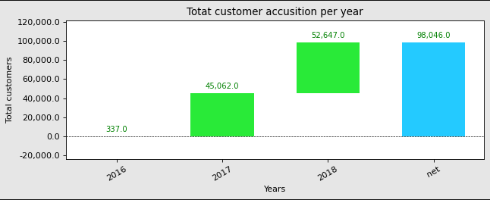
Cohort Analysis
The dataset only includes data for Q3 and Q4 2016, so the new customer count is very low, but after that there is significant customer growth in 2017 and 2018

Slide 6
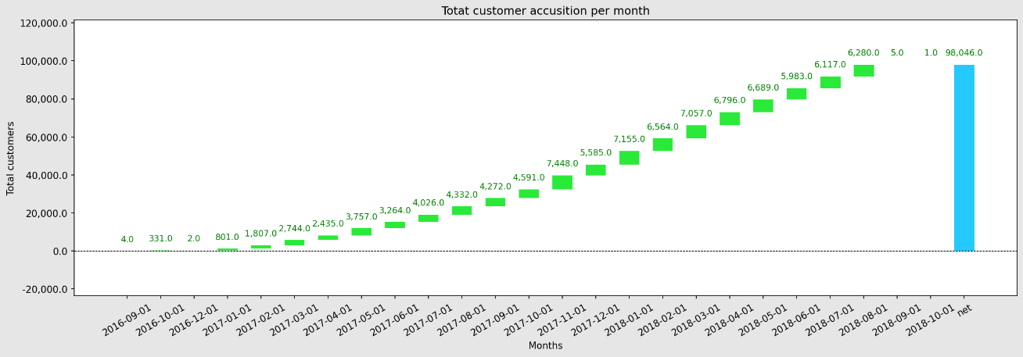
Year/month wise new customer registration
There is a linear growth and steep increase from the 3rd quarter of 2017
On an average near about 6000 new customers were being registered every month

Slide 7
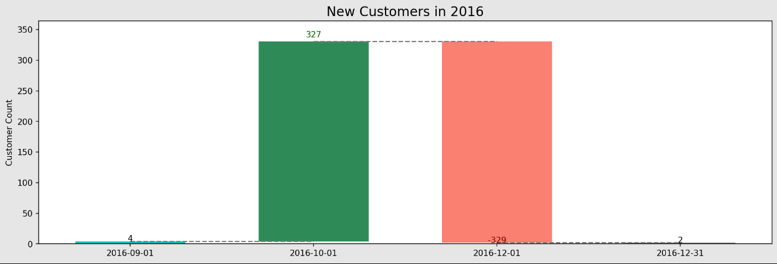
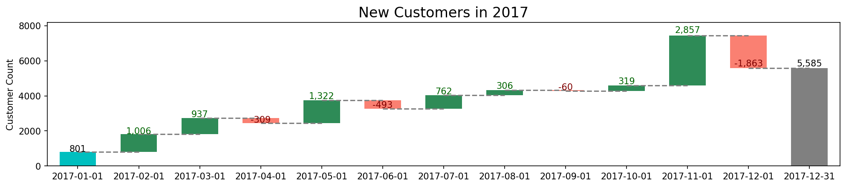
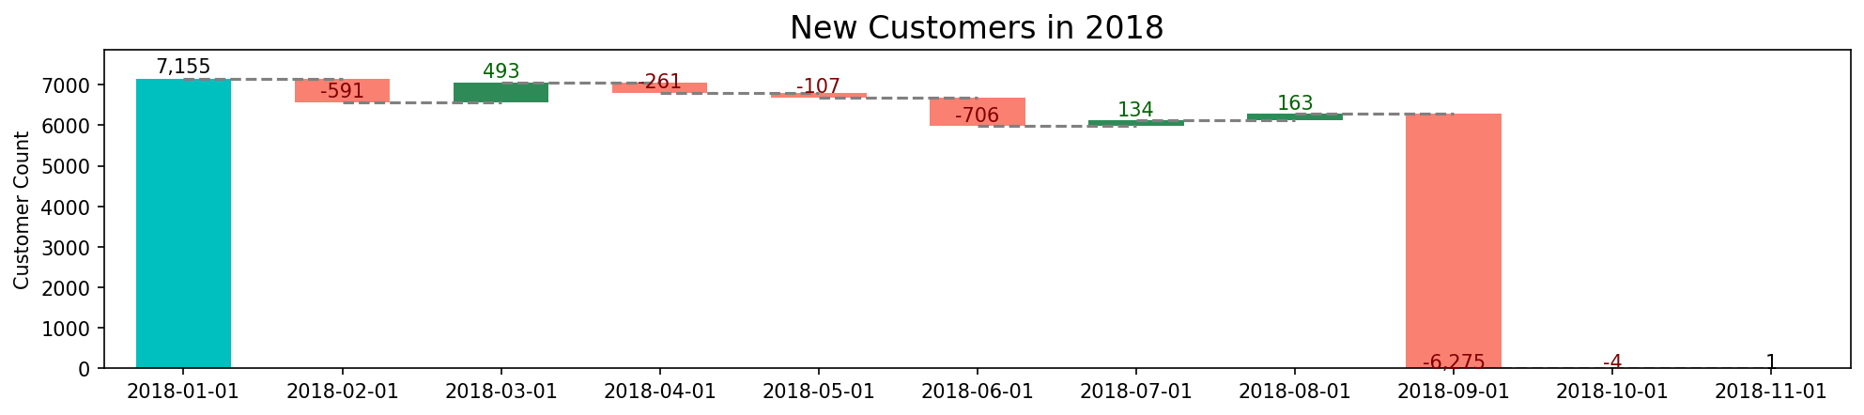

Slide 8
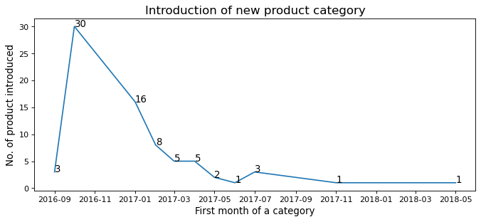
Galvanization by Product Categories

Slide 9
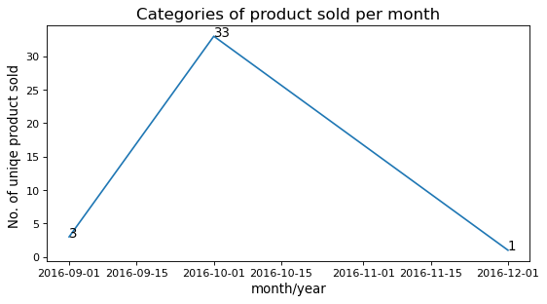
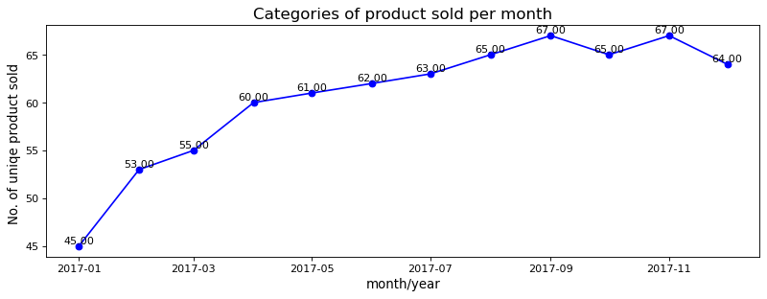
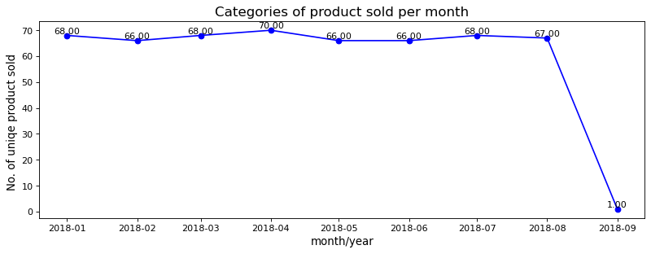
Product categories purchased per month

Slide 10
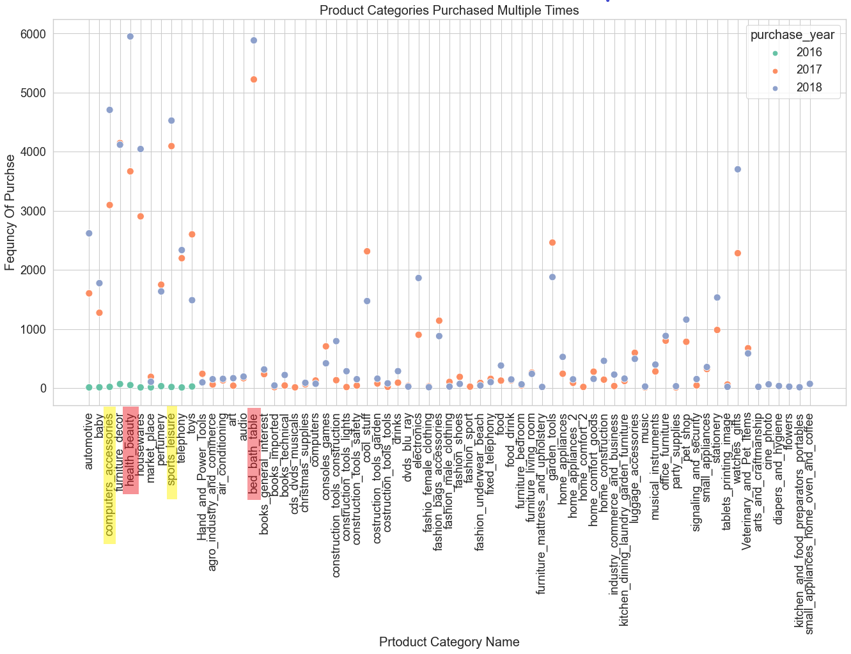
Highly purchased product categories.

Slide 11
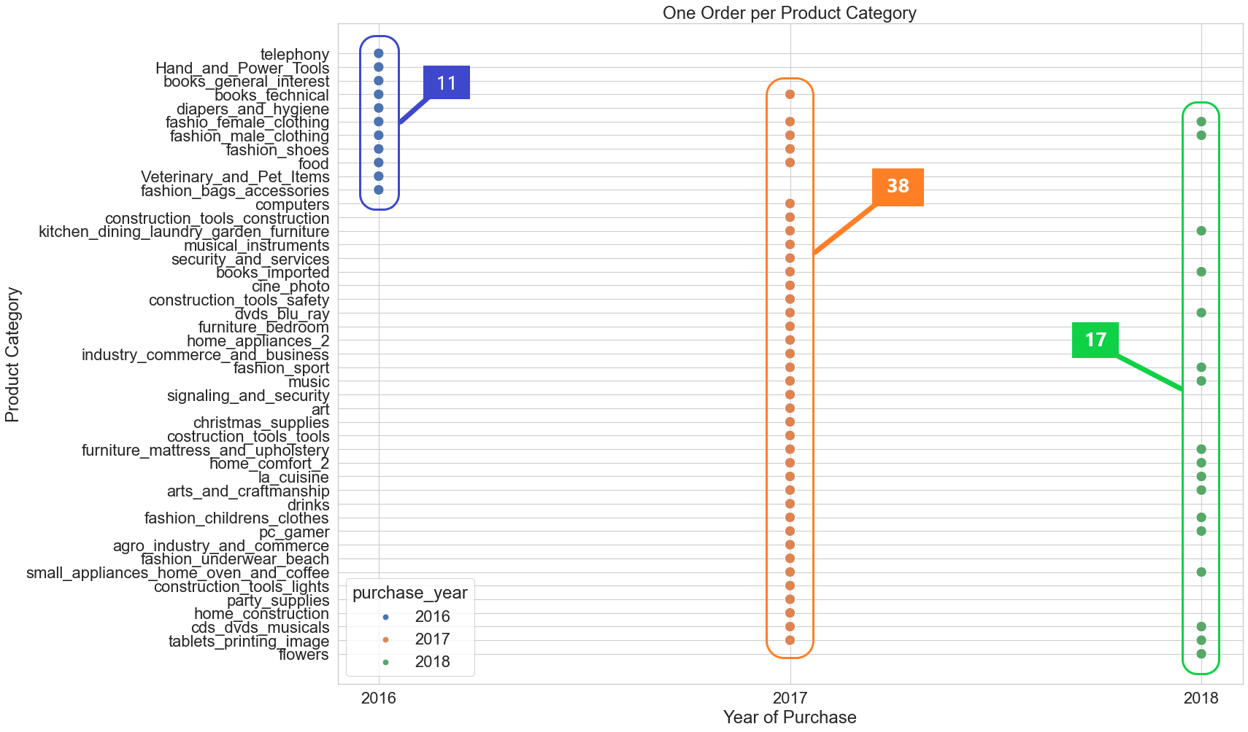
One Order per Product Category Per Month

Slide 12
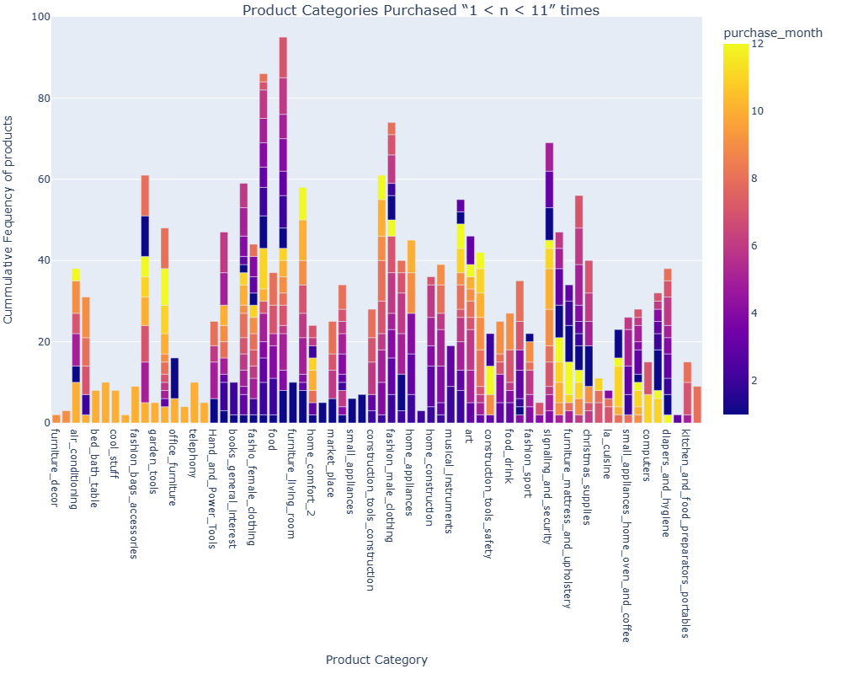
Product Categories Purchased “1 < n < 11” times
List below provides some most frequently ordered categories:
Furniture bedroom
Fashion beach underwear
Fashion Male Clothing
Signaling and Security
Fixed Telephony

Slide 13
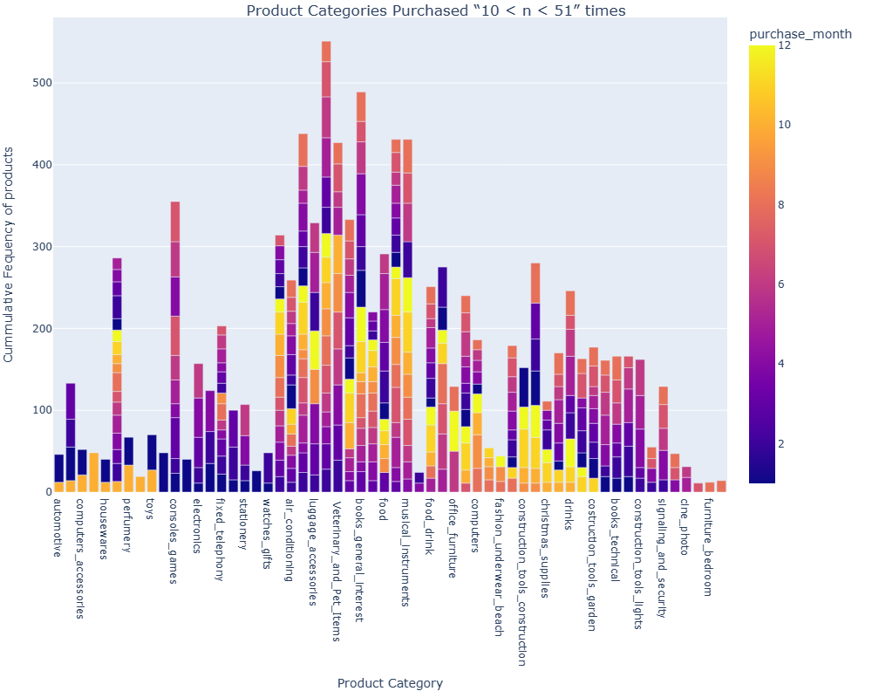
Product Categories Purchased “10 < n < 51” times
List below provides some most frequently ordered categories:
Small Appliances
General Interest books
Living Room Furniture
Musical Instruments
Products For Home Comfort
Veterinary and pet items

Slide 14
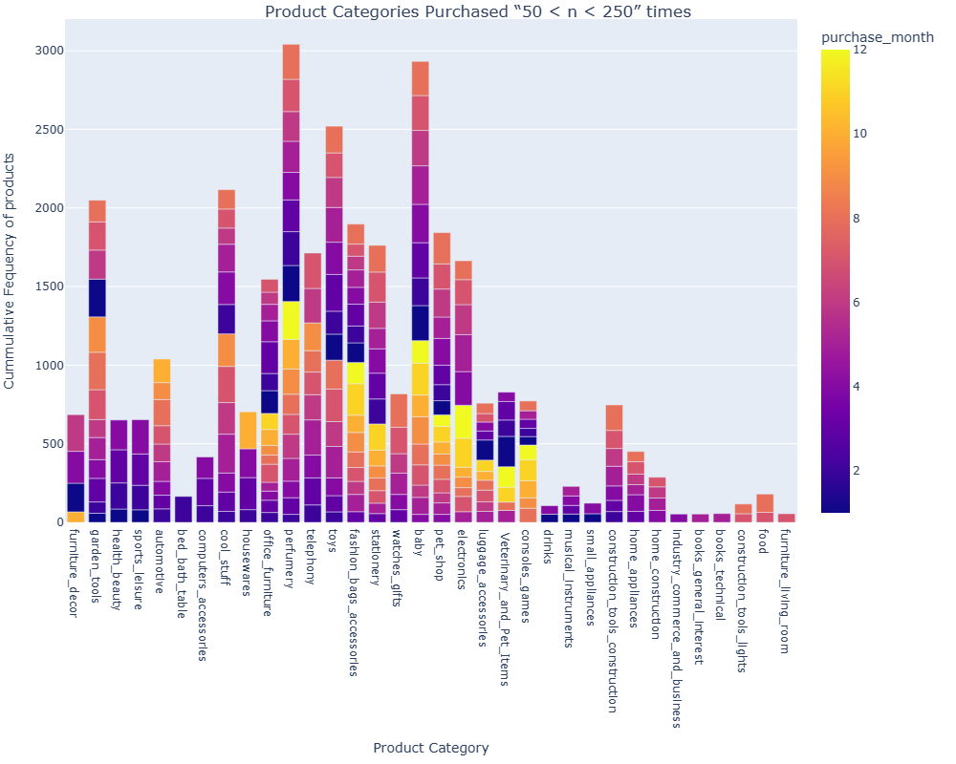
Product Categories Purchased “50 < n < 250” times
List below provides some most frequently ordered categories:
Perfumery
Baby products
Toys
Cool Stuff
Garden Tools

Slide 15
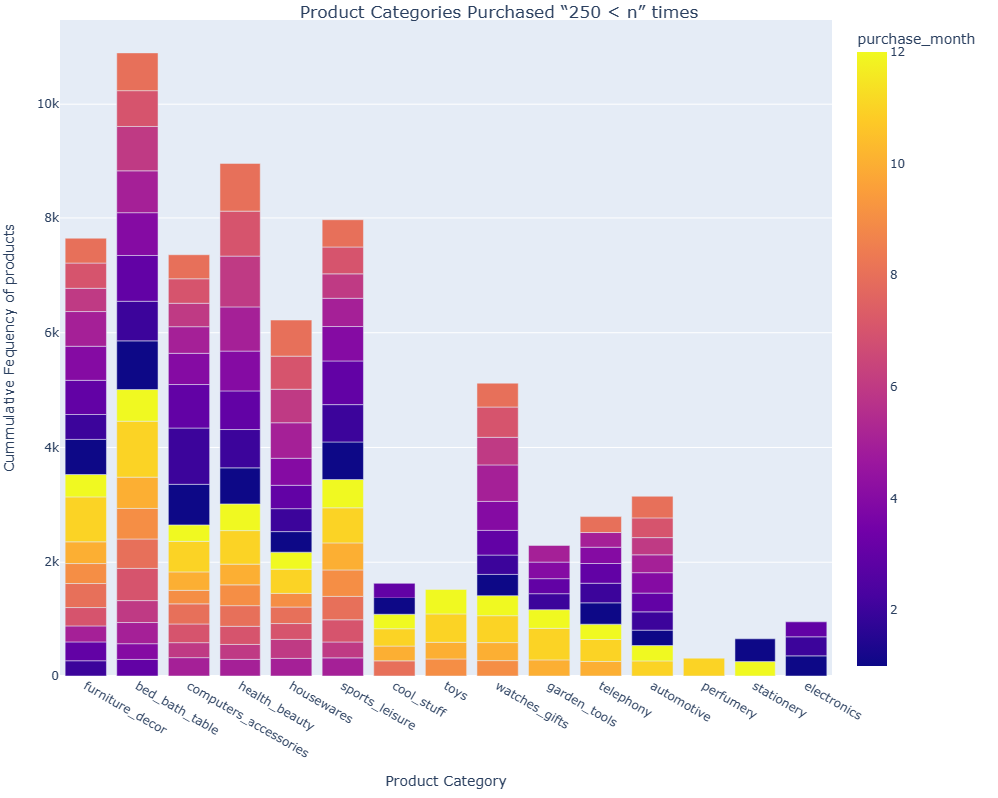
Product Categories Purchased “250 < n” times
List below provides some most frequently ordered categories:
Bed and Bath Tables
Health and Beauty Products
Sports leisure Products
Furniture Decor
Computer Accessories

Slide 16
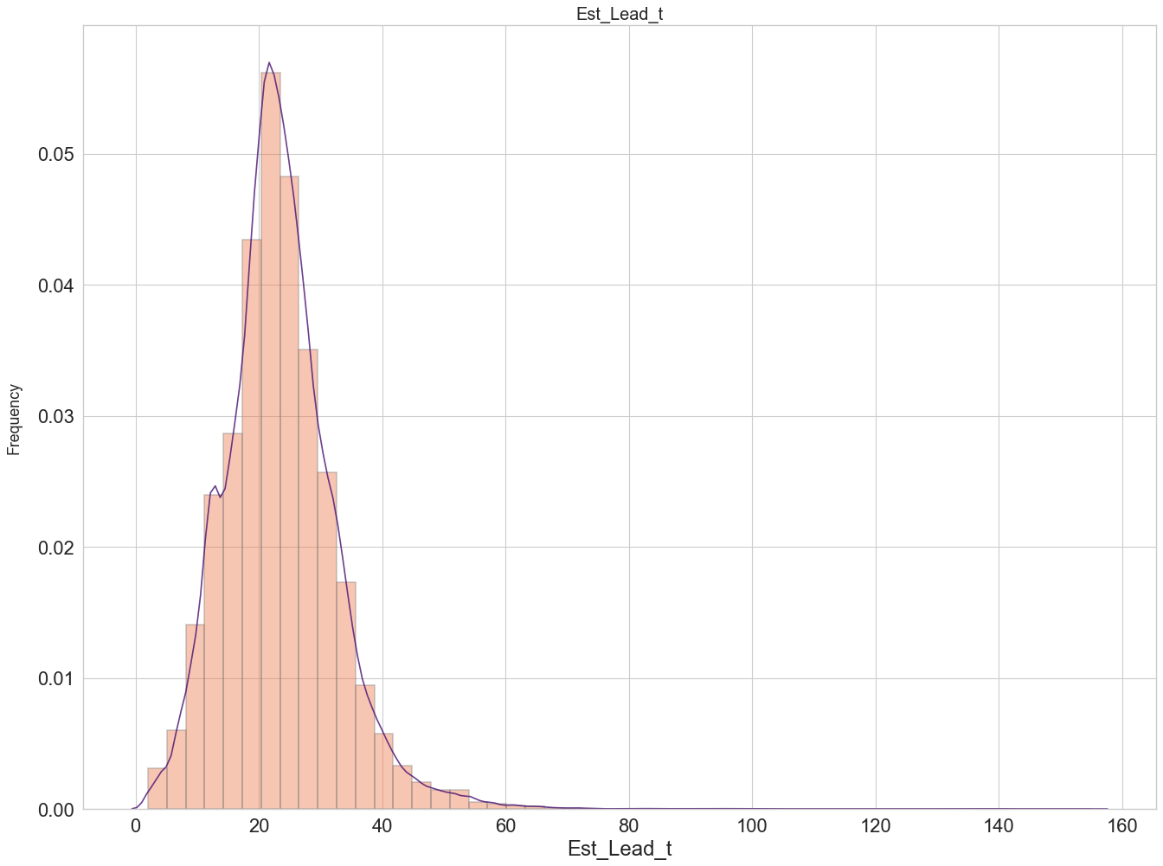
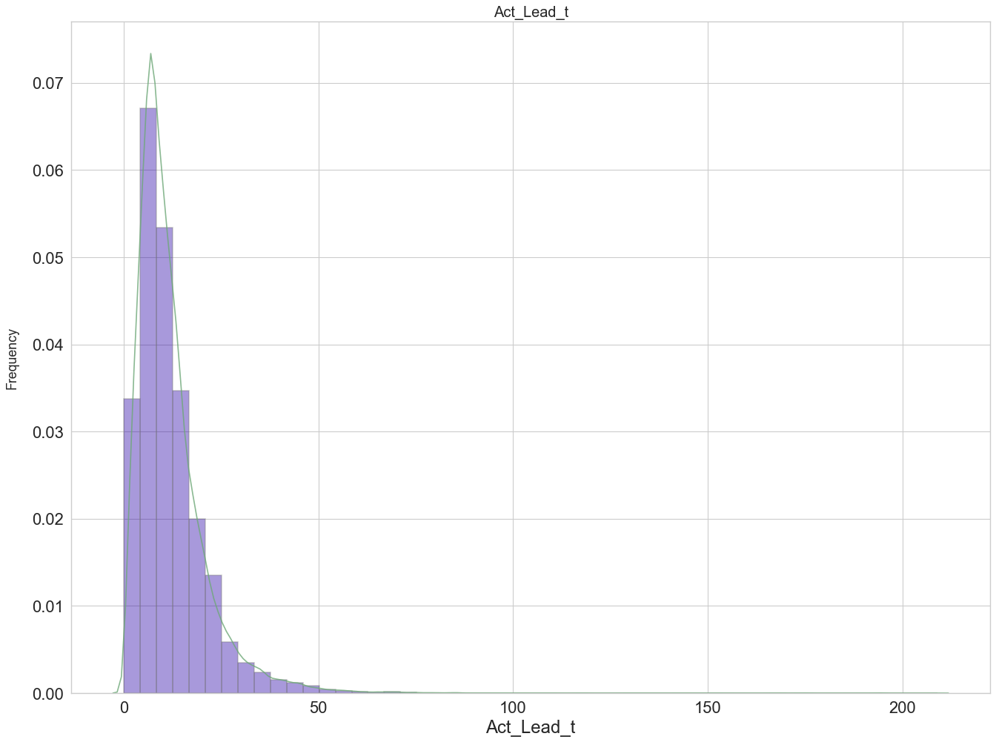
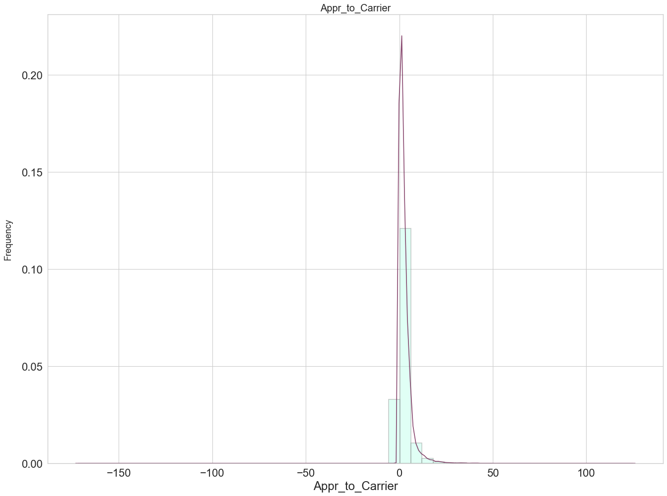
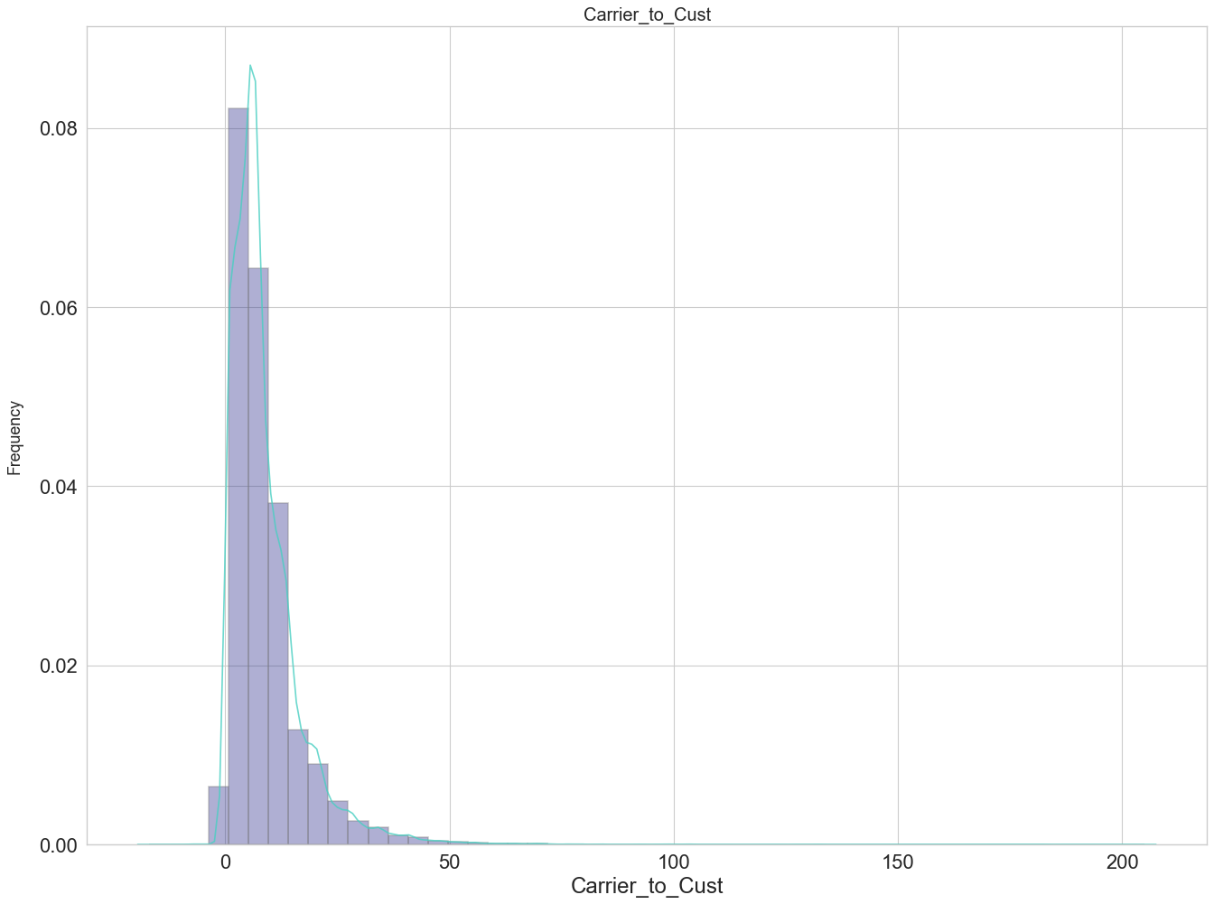
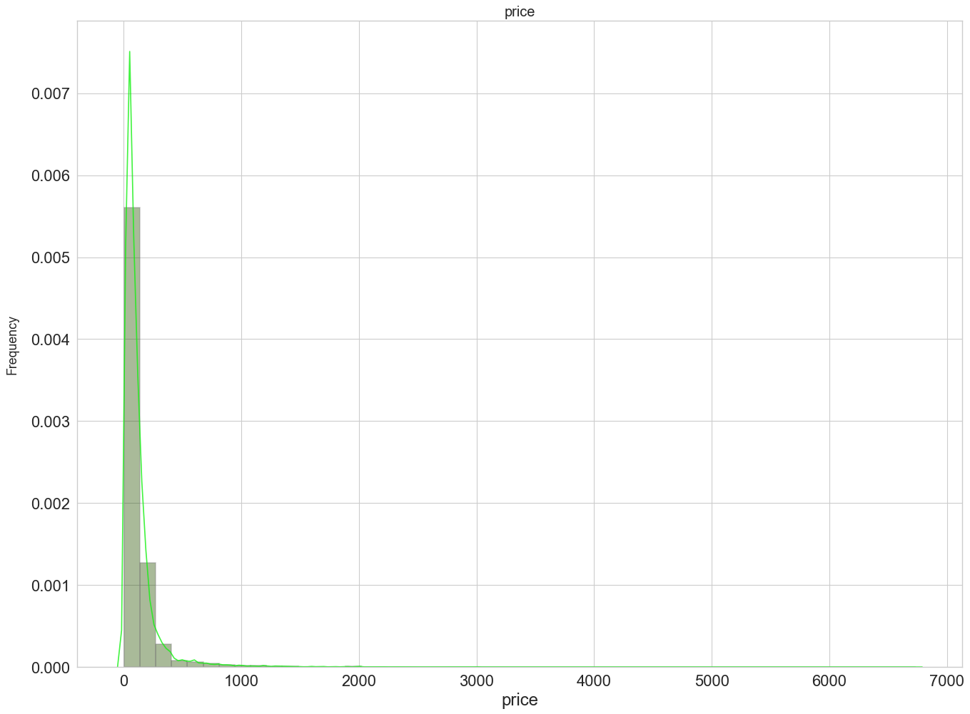
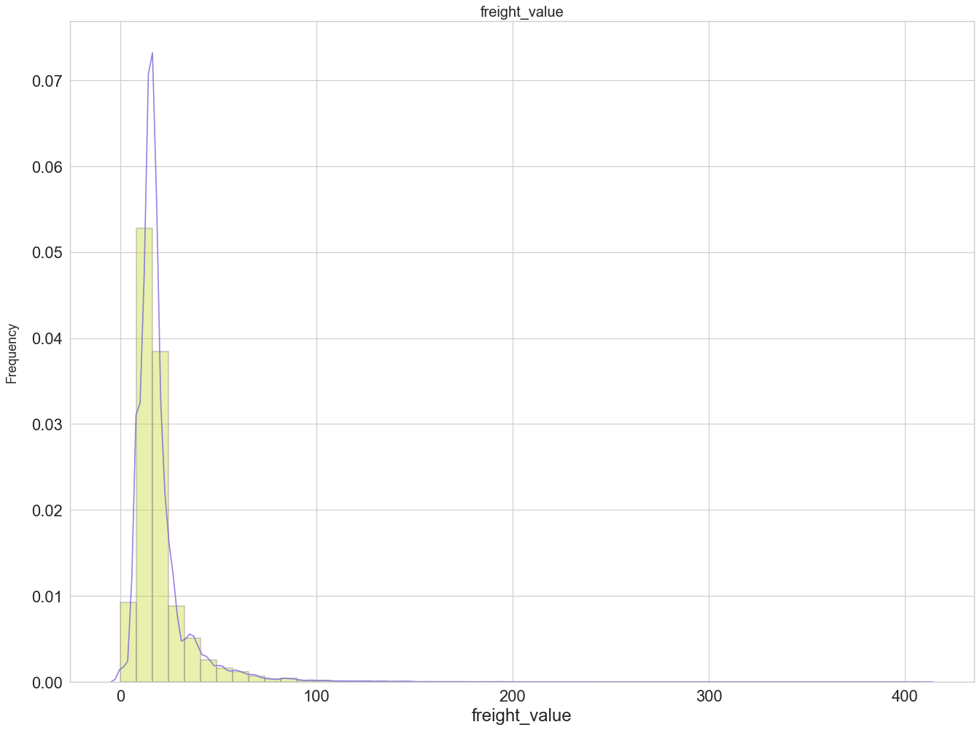
Statistical check of numerical variables

Slide 17
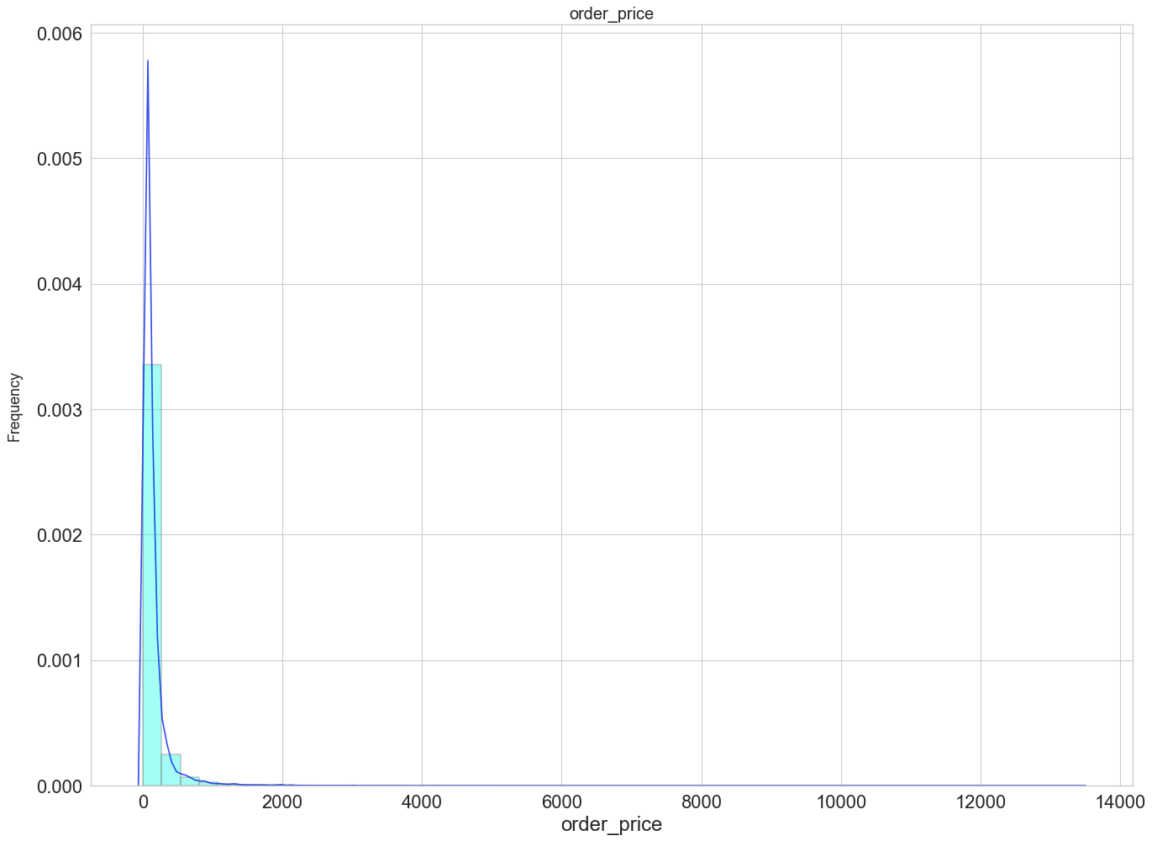
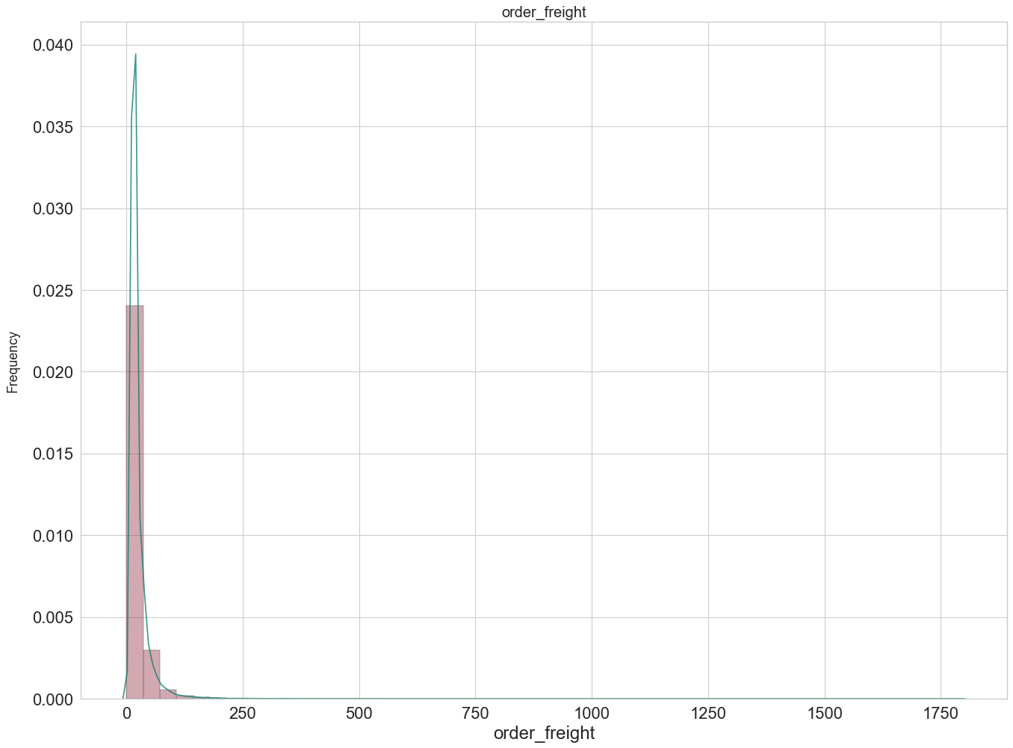
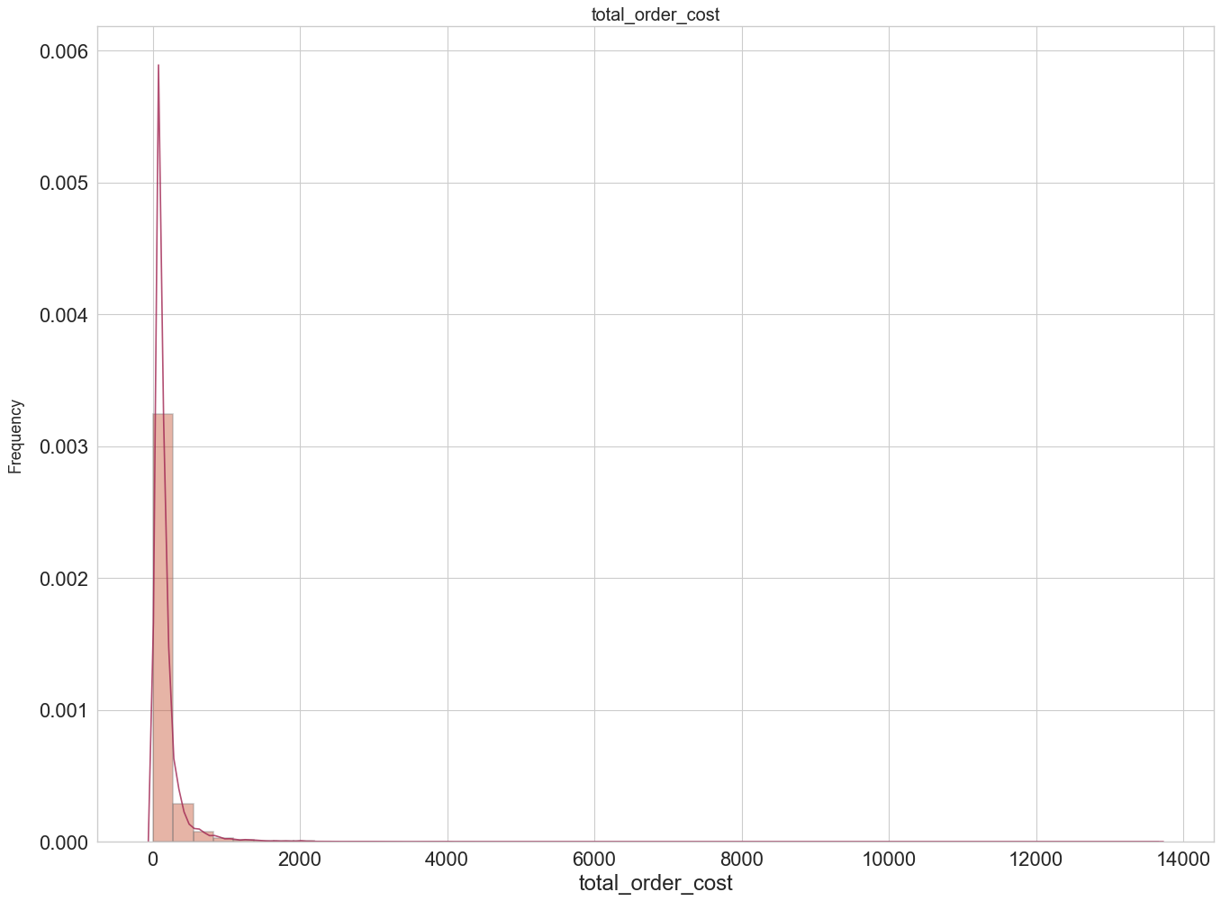
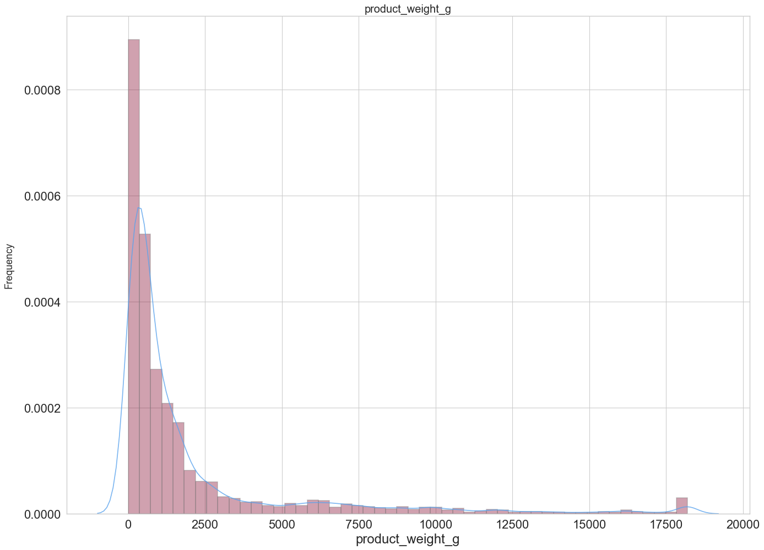
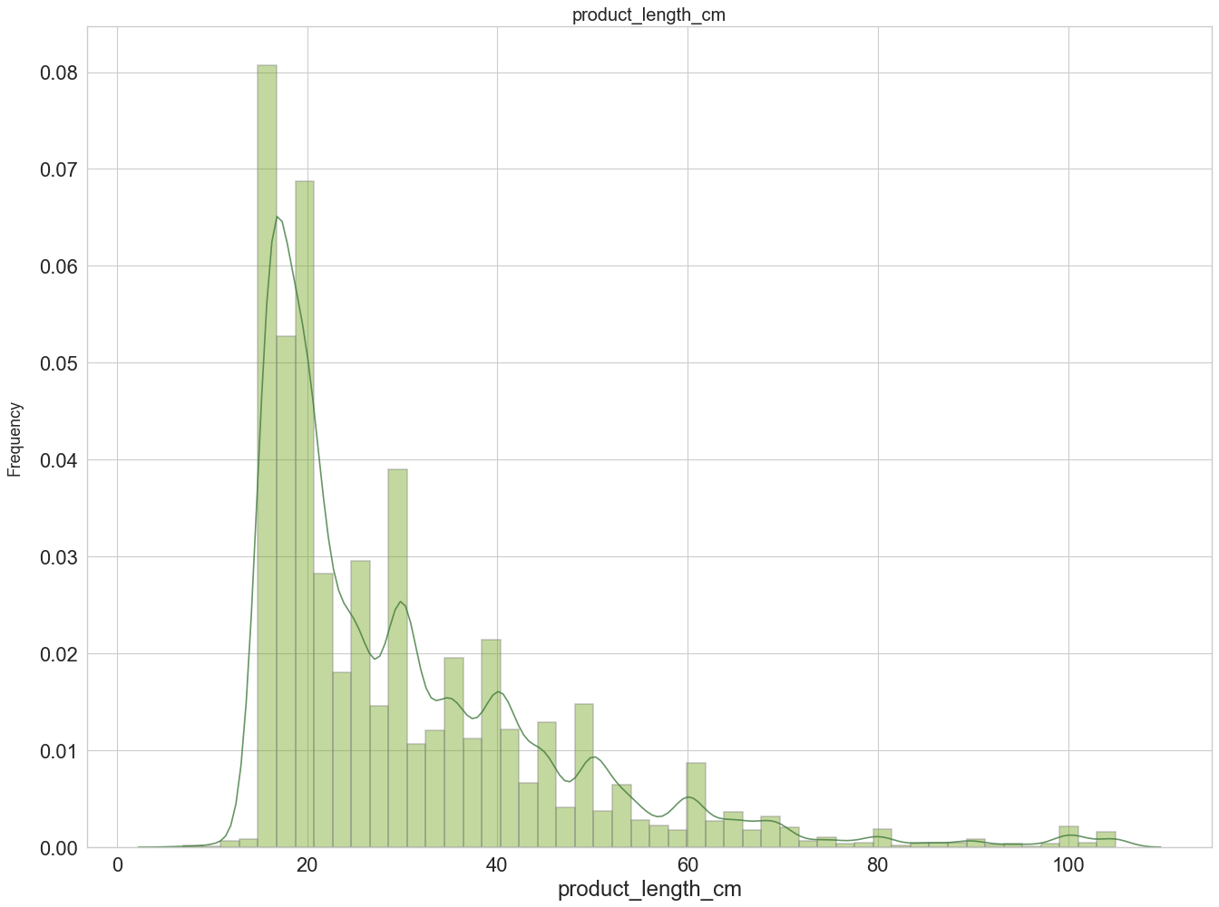
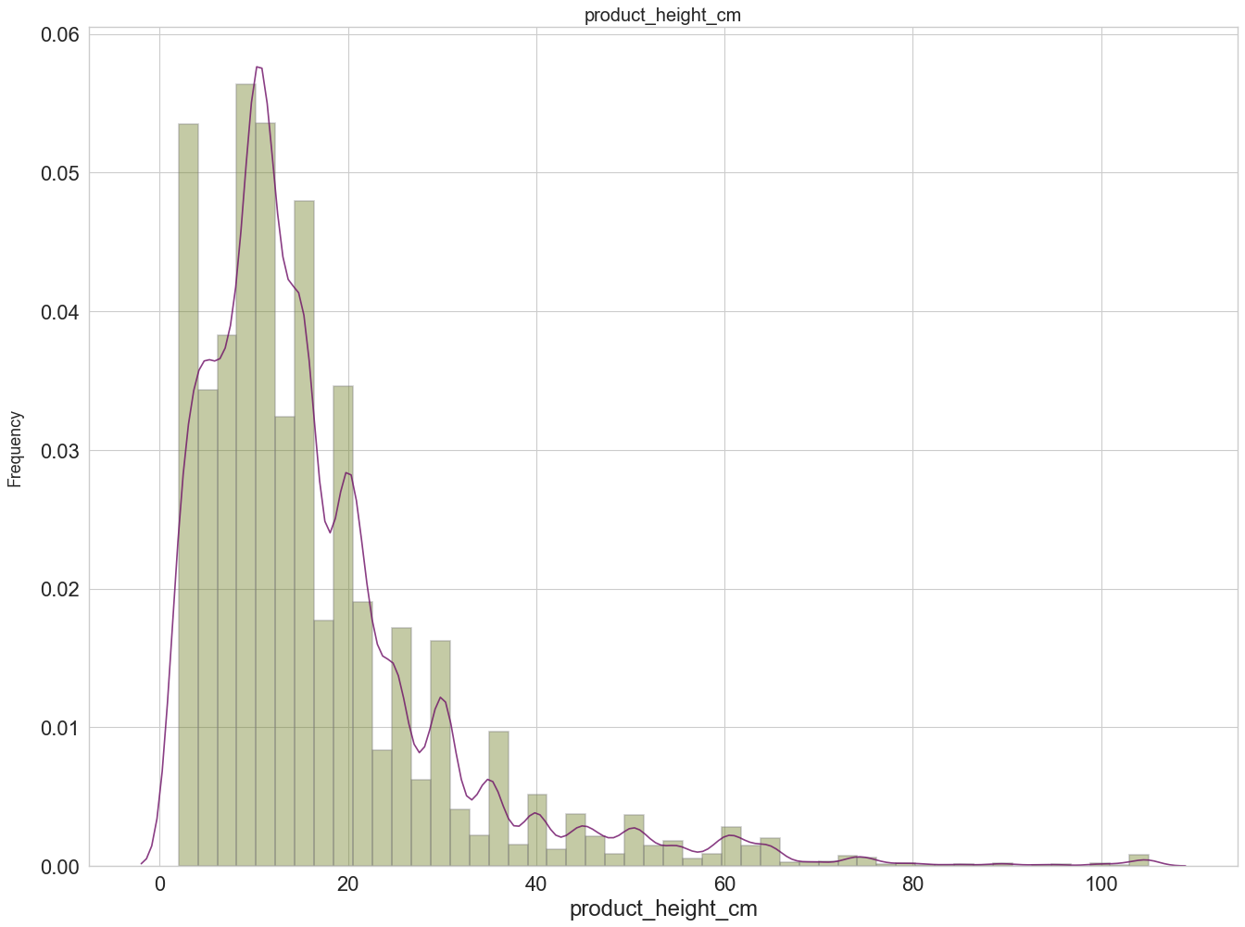
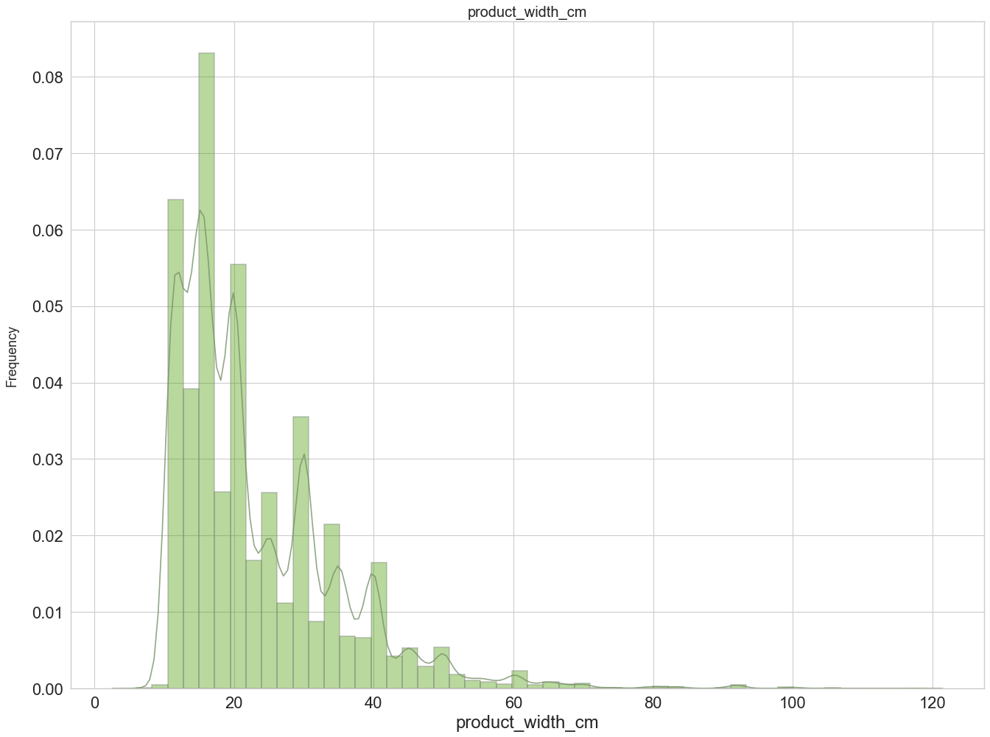
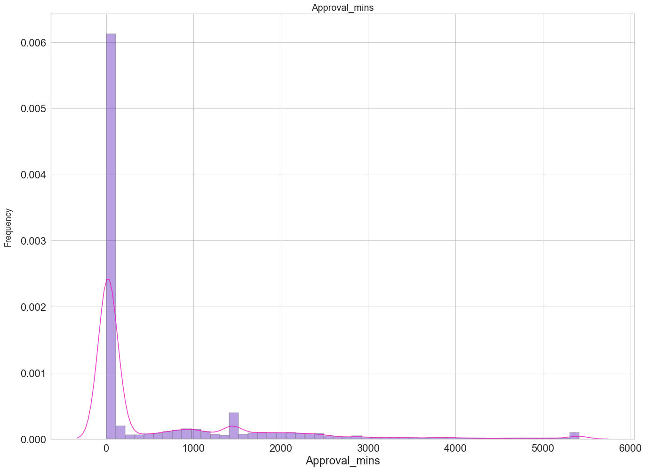
Statistical check of numerical variables

Slide 18
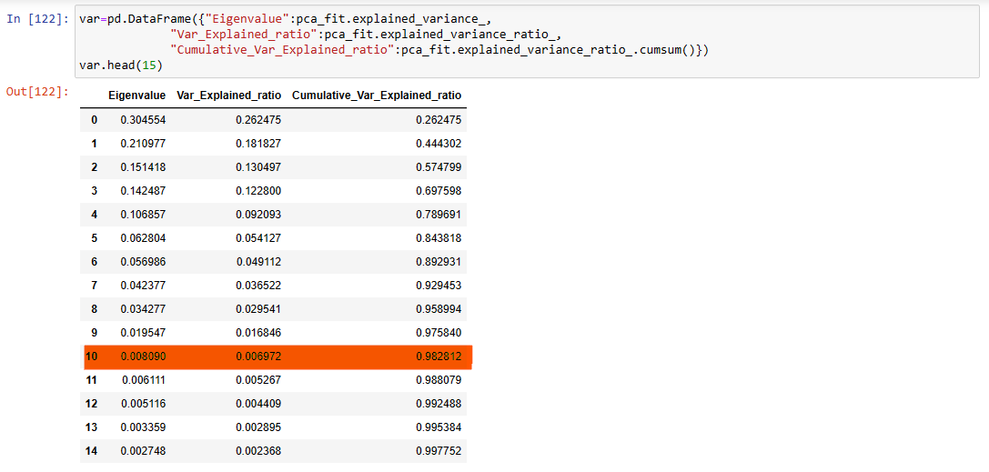
Principal Component Analysis

Slide 19
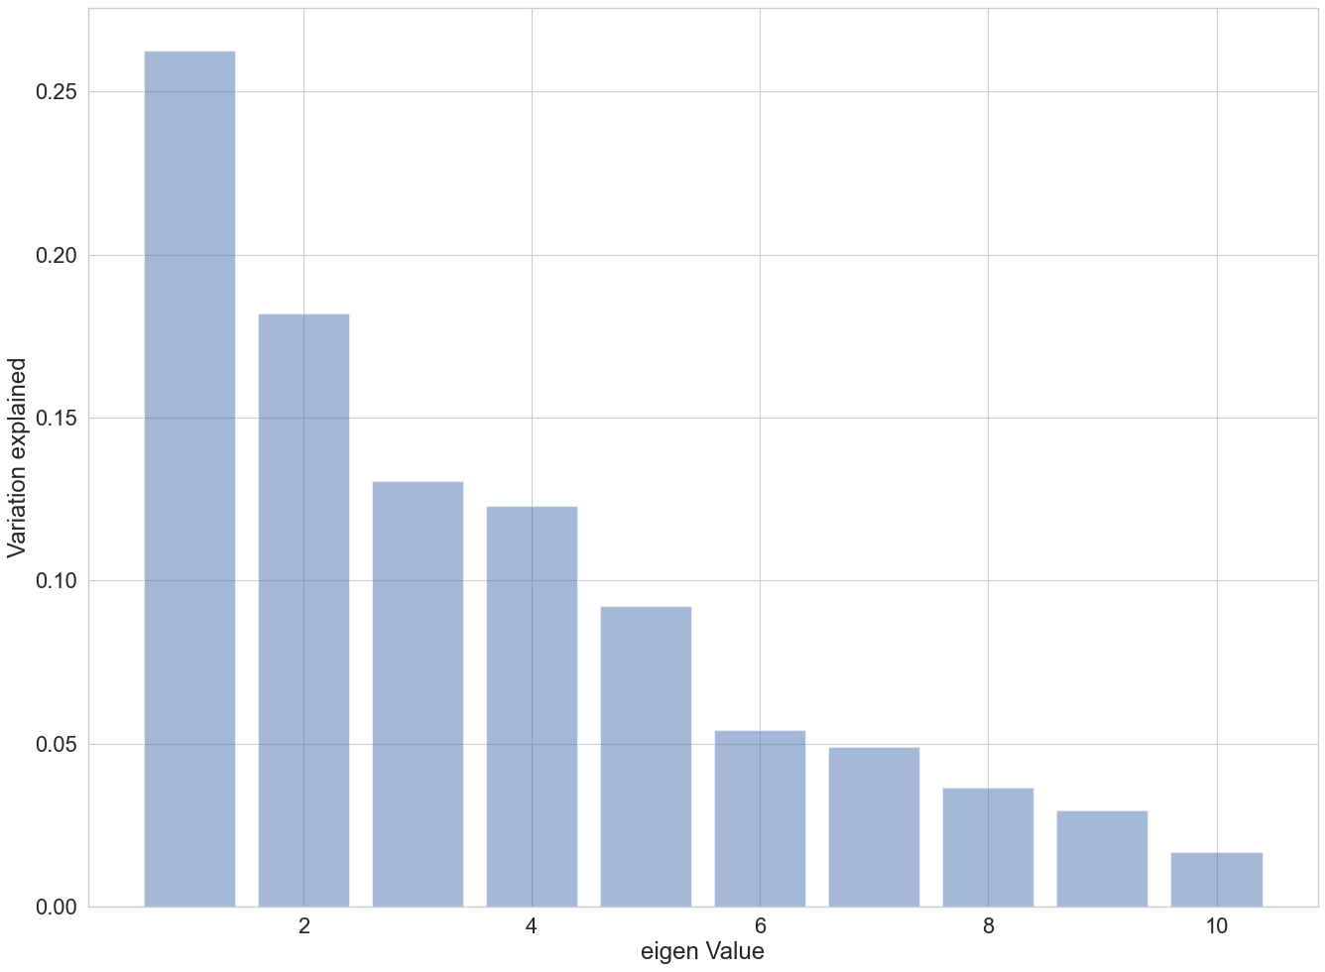
Graph for Variance Explained by 10 PCA Components

Slide 20
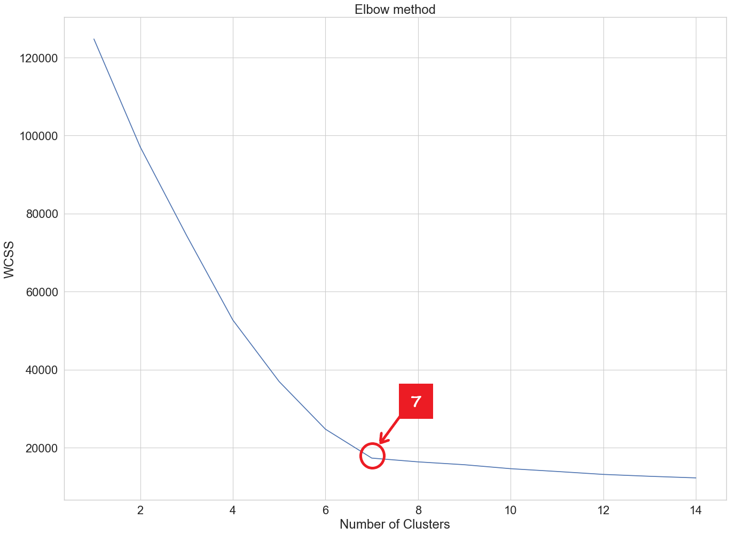
K-Means Clustering
Determining number of clusters using WCSS( Within cluster sum of square)

Slide 21
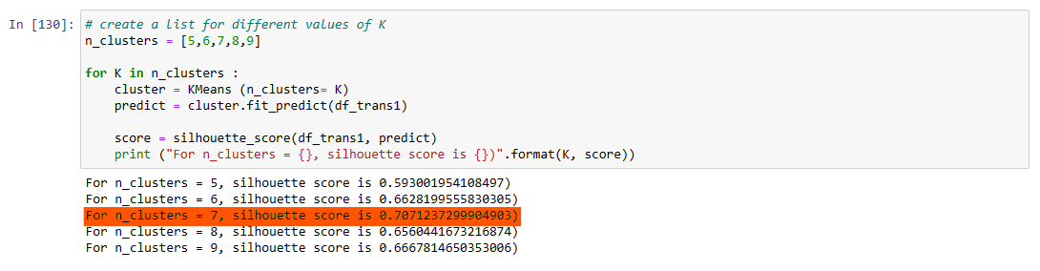
Silhouette Score

Slide 22
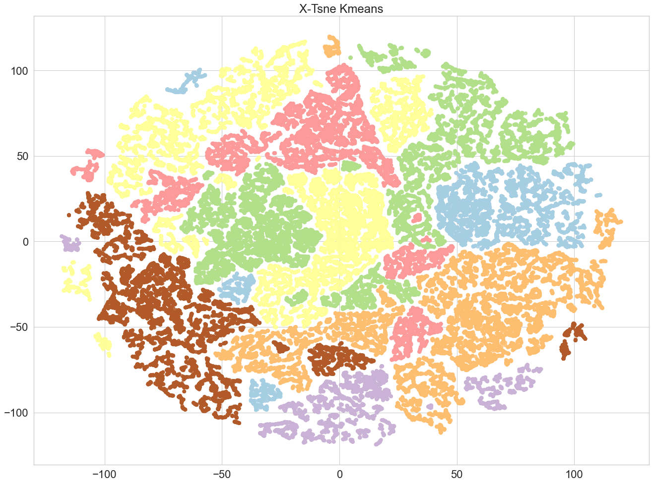
Formed Clusters

Slide 23
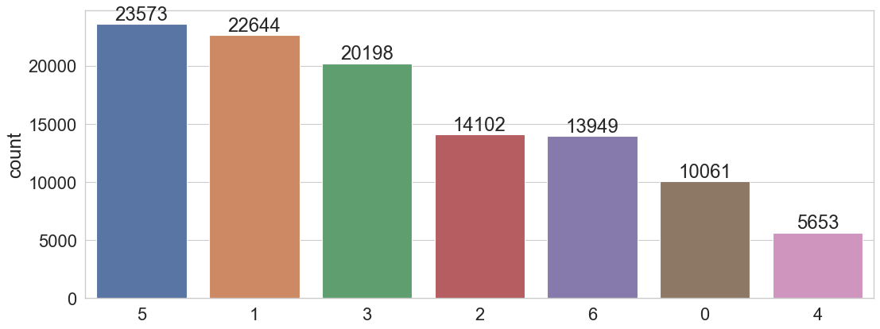
Number of Customer in Each Cluster

Slide 24
Important Variables For Defining Clusters
Estimated Lead Time: Is the estimated total time for a product to reach customer after placing the order.
Actual Lead Time: Is the actual total time for a product to reach customer after placing the order.
Approval to Carrier : Time take for the product to reach the carrier after the confirmation of the product purchase
Purchase Month: Columns provide the information of the month when the order is placed.
Freight Value: Delivery Cost/Item, charged from a customer.
Total Order Cost: Net price of product.
Product Height (cm): Height of the product in centimeters.
Product Weight (g): Weight of the product in grams

Slide 25

Summary
From this we can conclude that the customer base depends on the price of the product, the duration of delivery of the product after the order, the size of the product and the month of purchase.

Slide 26


Thank You
Sneha Rani Sarkar
PGA-25
snehasarkar081995@gmail.com
https://github.com/snehasarkar95

